Slide 1
The Role of Hypoxia in the Dynamic Tumor Microenvironment
Daniele Gilkes
Assistant Professor of Oncology
& Chemical and Biomolecular Engineering
Breast and Ovarian Cancer Program
Johns Hopkins University School of Medicine

Slide 2

Breast Cancer
Most common cancer in women in the U.S.
2nd leading cause of cancer-related death in women in the U.S.
1 in 8 women will be diagnosed with breast cancer in her lifetime
In 2017, more than 250,000 new cases of invasive breast cancer are expected to be diagnosed among women
In 2017, more than 40,000 women are expected to die from breast cancer

Slide 3
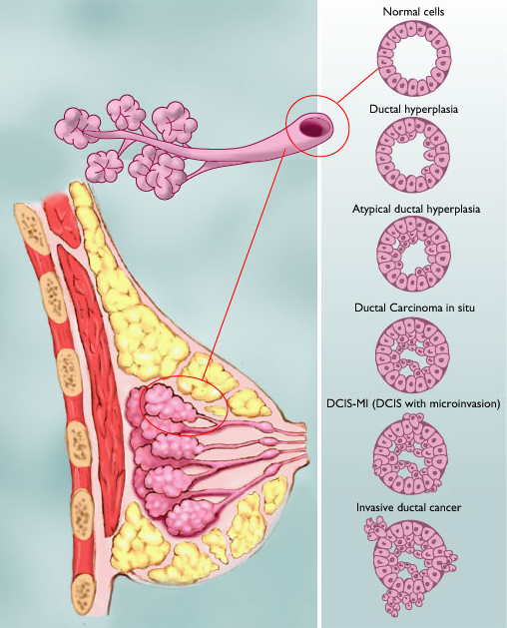
Illustration by Mary K. Bryson

Slide 4
Metastasis
The spread of cells from the primary site to a distant organ
Wirtz, D., Konstantopoulos, K., & Searson, P. C. Nature Reviews Cancer (2011)

Slide 5
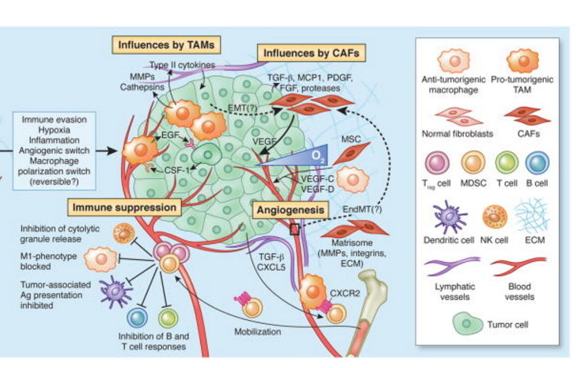
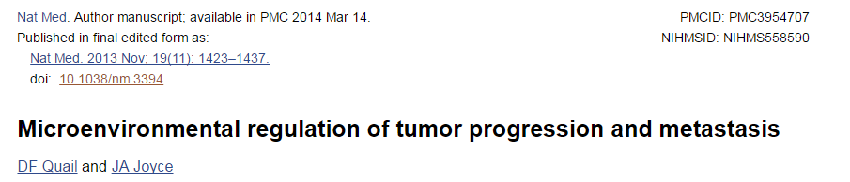
Complexity of the tumor microenvironment

Slide 6
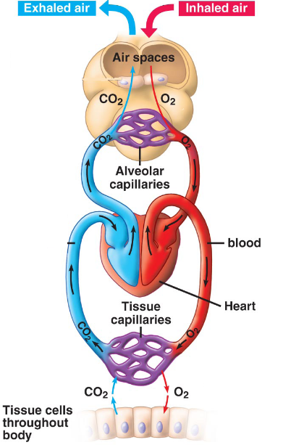
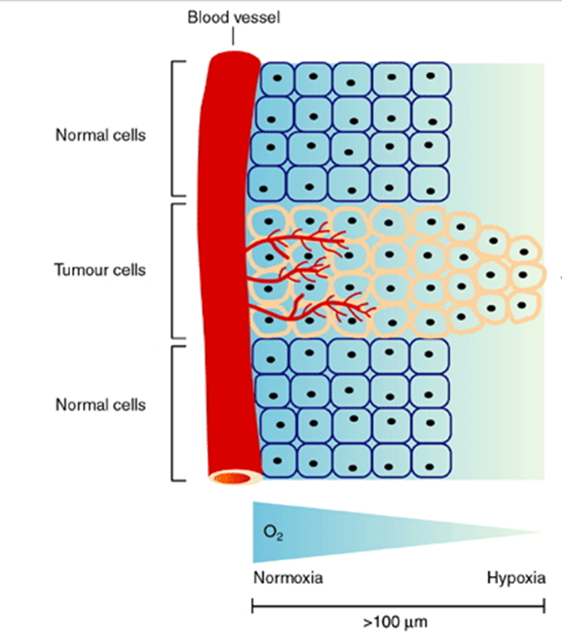
O₂ in human physiology & cancer
P 0₂ (160mmHg)
~21%
P 0₂ (104 mmHg)
~14%
P 0₂ (40 mmHg)
= 5%
P 0₂ (100 mmHg)
~14%
Notes:
The partial pressure of oxygen (PO₂) is 160mmHg which is equivalent to 21% O₂. O₂ enters the body in the form of room air in the upper airway and PO₂ drops to about 100mmHg in the alveolar space where the diffusion of gasses occurs: oxygen diffuses from the alveoli into the blood and carbon dioxide from the blood into the alveoli. Blood enters the tissue capillaries containing 100mmHg and leaves the tissue through the venous system at a partial pressure of 40mmHg.
In cancer the appropriate physiological levels of oxygen are altered in the tissue. This is the result of rapid cancer cell proliferation, combined with structural and functional abnormalities of tumor blood vessels that are generated through angiogenesis and result in regions in solid tumors that have reduced oxygen availability. And in this schematic you with note that hypoxia can develop over short distances from viable blood vessels in this 100uM.
104mmHg--13.68%,65mmHg—8.55%,10mmHg—1.32%,5mmHg—0.66%,2.5mmHg—0.33%

Slide 7
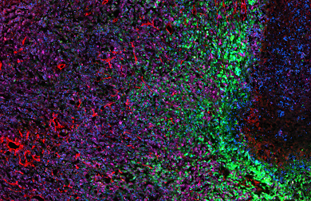
Intratumoral Hypoxia
Necrosis
Blood Vessels
Hypoxic Cells
Non-hypoxic cells
Nuclei
Notes:
In this orthotopic tumor section you can see hypoxic cells in green near a region of necrotic tissue. Non-hypoxic cells are purple an CD31+ cells which line blood vessels are stained in red. As cells are located farther from blood vessels they

Slide 8
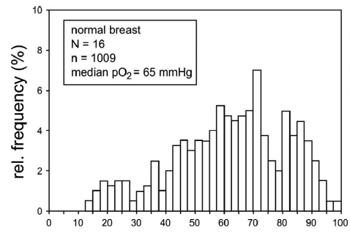

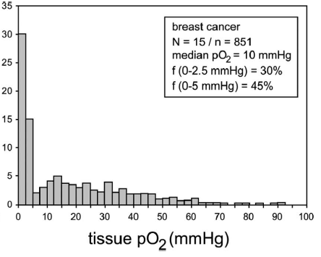


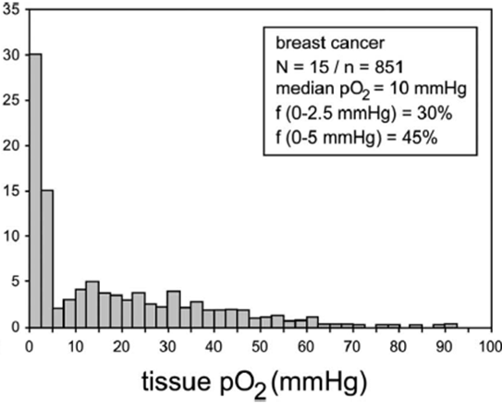
O₂ in normal and breast cancer tissue
Tatum et al. Int. J. Radiat. Biol. 2006
Eppendorf Electrode: O₂ + 2H⁺ + 2e⁻ → H₂O₂
Notes:
The oxygen content of tissue can be measured albeit invasively with the use of an eppendorf electrode. Oxygen is reduced at the surface of the platinum electrode when a voltage is applied and the change in current has a stoichiometric to the oxygen concentration. Reduced. And many studies have been performed to study breast tissue. In 2006 Tatum compiled several studies. In normal breast tissue he combined 16 studies which evaluated over 1000 patients and determine that the median oxygen concentration in breast tissue is 65mm Hg or 8.5% oxygen. In 15 studies of over 800 breast cancer patients he determined that the oxygen concentration was 10mm of Hg or 0.5% oxygen.

Slide 9
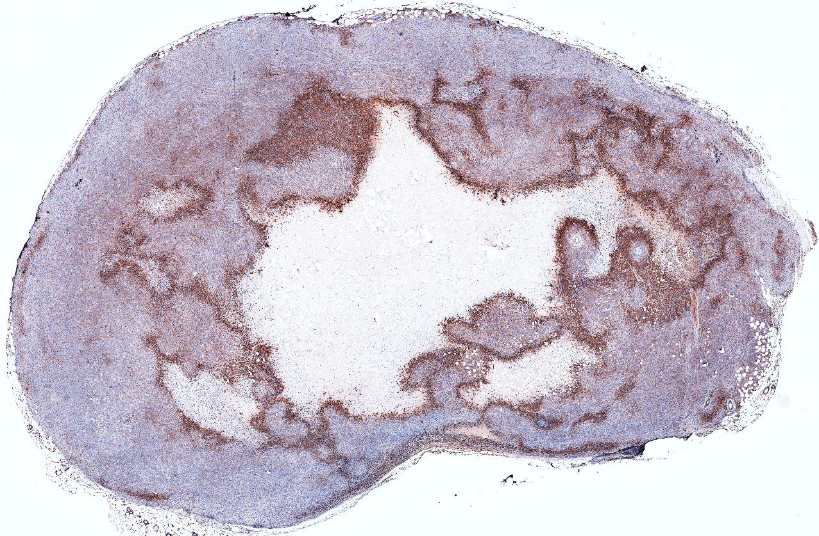
O₂ in vivo breast cancer model
5mm

Slide 10
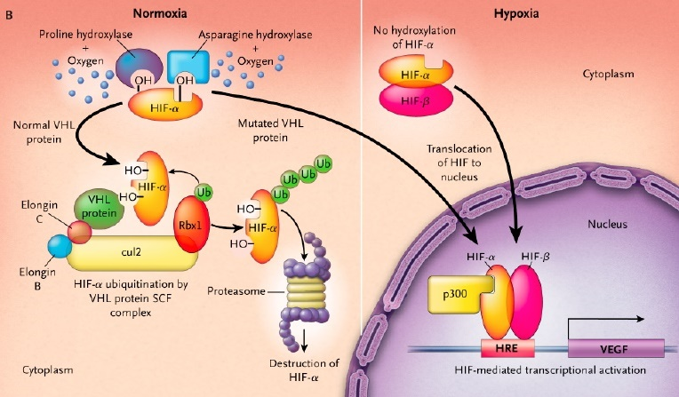
Hypoxia-inducible factors -- HIFs Master regulators of O₂ homeostasis
Cohen et al. N Engl J Med 2005
Notes:
So how are the hypoxia-inducible factors induced by hypoxia?
Specific proline (P) residues residing in a conserved core LXXLAP motif in the HIF-1α or HIF-2α are subjected to O₂ dependent hydroxylation by prolyl-4-hydroxylase domain proteins (PHDs). The hydroxylated proline residues on HIF is required for interaction with the von Hippel-Lindau VHL tumor suppressor protein (VHL), which is the substrate-specific component of an E3 ubiquitin ligase that targets hydroxylated HIF-1α or HIF-2α for ubiquitination and subsequent proteasomal degradation
Under hypoxic conditions, these enzymes are inactive which leads to HIF-α stabilization and accumulation. After dimerization with HIF1β and translocation to the nucleus, HIFs bind to the consensus DNA sequence 5’-RCGTG-3’, which is embedded within hypoxia response elements (HREs) in target genes, and activate their transcription. More than 200 genes have been show as HIF targets, which involve in metabolic reprogramming, erythropoiesis, angiogenesis and more.
The above mechanism represents the canonical O₂-dependent regulation of HIFs by hydroxylases, and emerging reports have shown that there are multiple O₂-independent pathways regulating HIFs activity, for example, through post-transcriptional modification of HIFs protein, through effects on PHDs activity and through direct interaction with HIFs (Prabhakar and Semenza, 2012).
Three PHDs, PHD1, PHD2 and PHD3, which are encoded by EGLN2, EGLN1 and EGLN3 respectively, have been identified to date in mammalian cells. PHDs belong to the Fe²⁺ and 2-oxoglutarate (α-ketoglutarate) dependent dioxygenase superfamily and the reaction that they catalyze is represented as follow:
PHD-Fe²⁺+HIF-proline+2-OG+O₂→ PHD-Fe³⁺+HIF-4-hydroxy-proline +Suc +CO₂
2-OG stands for 2-oxoglutarate and Suc stands for succinate. Ascorbate is also required, for it reduces Fe³⁺ to Fe²⁺.

Slide 11
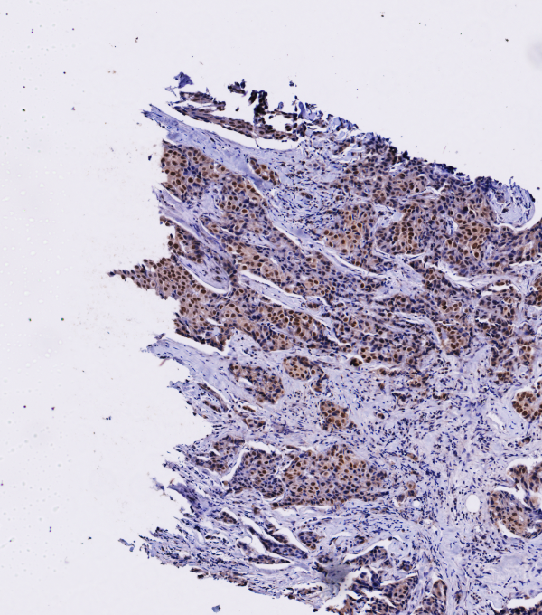
HIF-1

Slide 12
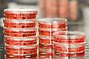
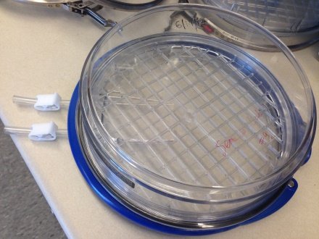
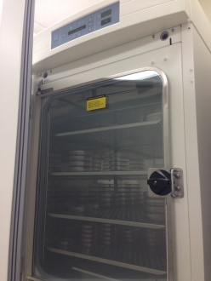
20% O₂
1% O₂
Low Levels of HIFα
High Levels of HIFα

Slide 13
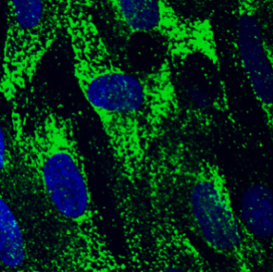
Hypoxia promotes fibrillar collagen deposition
20% O₂
Day 1
Day 2
Day 3
Day 4
Day 5
1% O₂
1% O₂
Human Fibroblast Cells

Slide 14
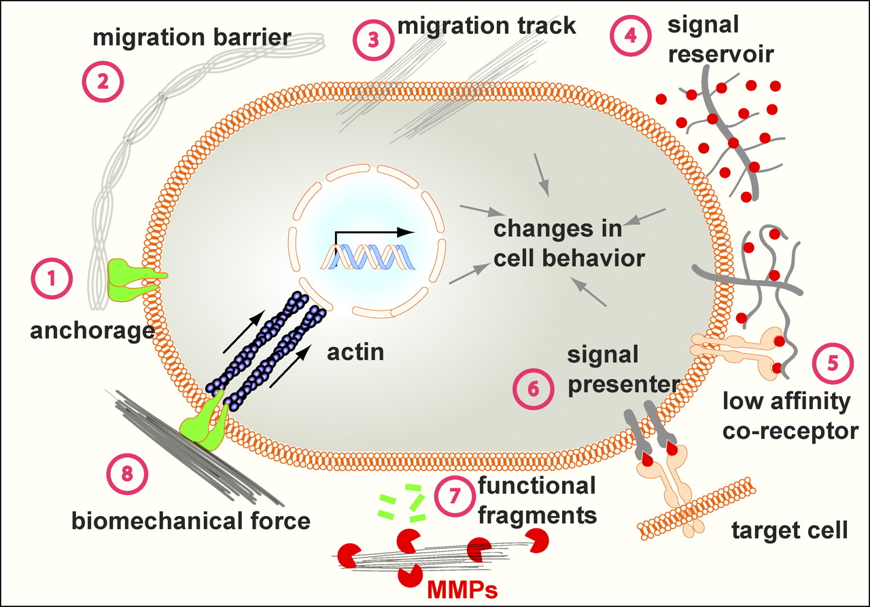
The Extracellular Matrix
Pengfei Lu et al. J Cell Biol 2012;196:395-406

Slide 15
Deriving cell-free ECM
Day1
Day5
20% or 1% O₂
Remove fibroblasts
Fibronectin
Collagen I
Merge
20% O₂
1% O₂

Slide 16
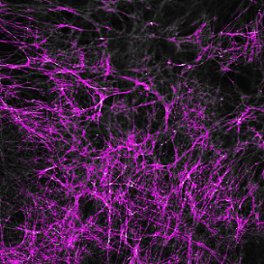
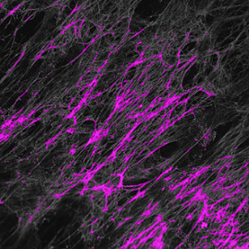
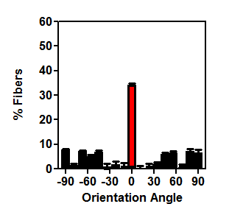
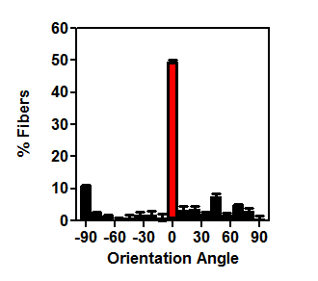
Hypoxic ECM is highly aligned
20% O₂
1% O₂
50%
35%
Notes:
We measured individual fibronectin fiber orientation with respect to the modal angle (set to 0◦).

Slide 17
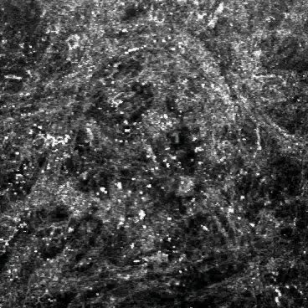
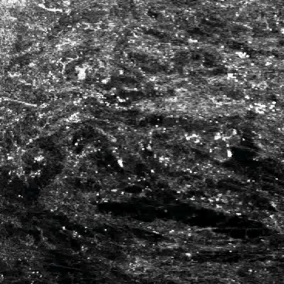
A collagen rich ECM promotes cell migration and directionality

Slide 18
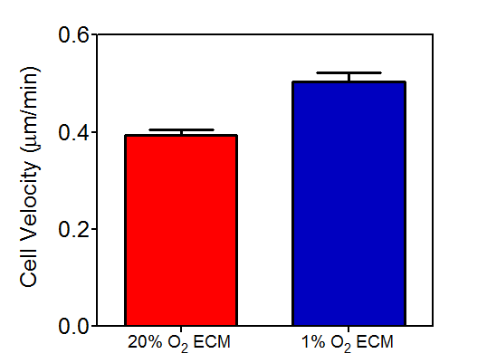
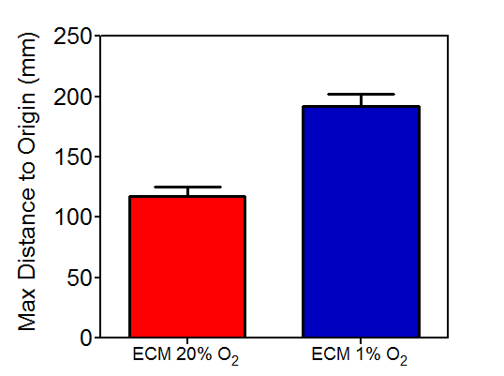
A collagen rich ECM promotes cell migration and persistence
ECM 20% O₂
***
***
ECM 1% O₂

Slide 19
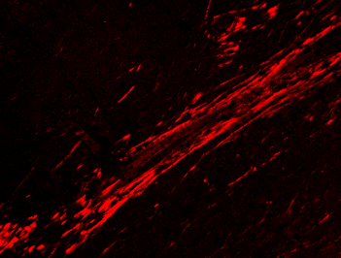
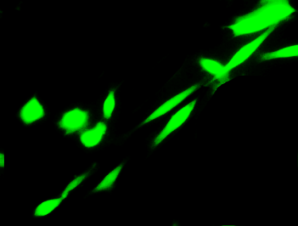
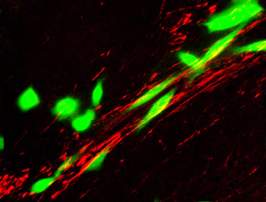
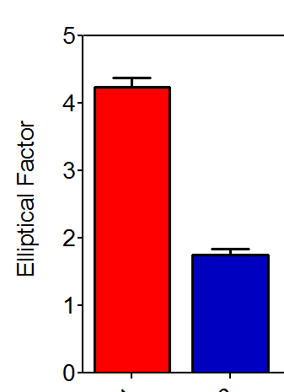
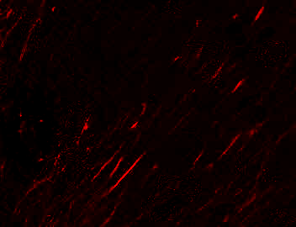
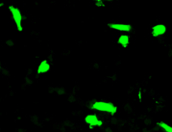
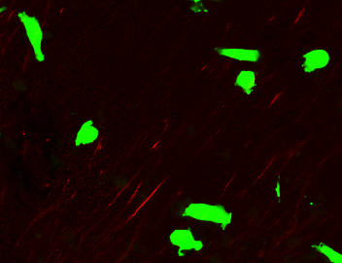
Invasive Morphology
Collagen
CMFDA
Overlay
Hypoxic
Normoxic
Hypoxic
Normoxic

Slide 20
Biologists may ask: What is the mechanism of enhanced collagen production?
Physicists may ask: How do changes in the microenvironment alter the physical properties of the tumor?
Clinicians may ask: Is it important for tumor progression?
Systems Biologists may ask: How can we integrate the many processes that are occurring concurrently?

Slide 21
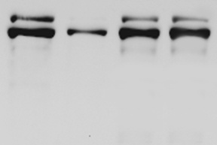
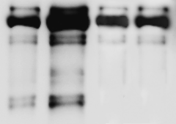
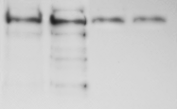
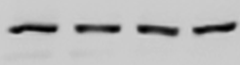
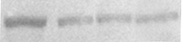
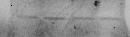
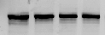
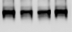
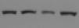
Where is the collagen?
ECM
Conditioned
Media
Cells
shEV
sh1α
shEV
sh1α
shEV
sh1α
20%
1%
20%
1%
20%
1%
20%
1%
20%
1%
20%
1%
170
Pro-C1 α1
130
pN
100
pC
70
C1 α1
Ctrl --
FN --
Intracellular
Conditioned Media
ECM

Slide 22
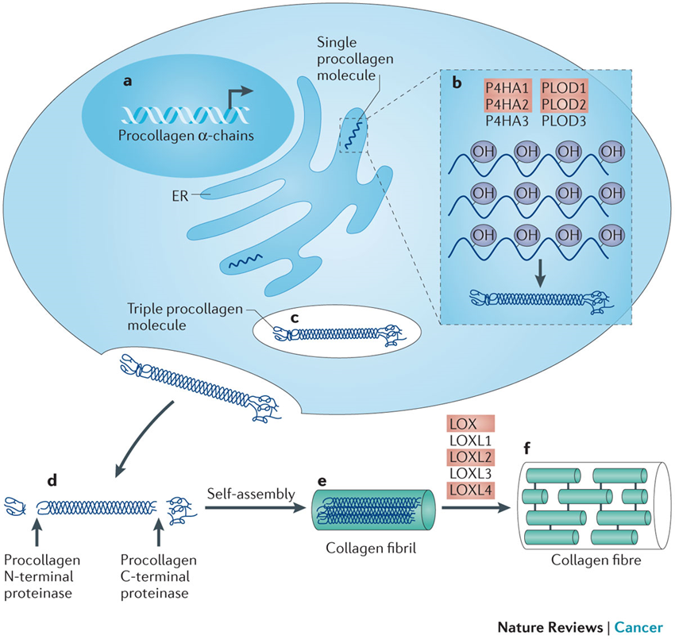
Collagen Biogenesis
Gilkes, D.M. et al. Nat Reviews Cancer 2014
Notes:
Collagen biosynthesis can be divided into intracellular (1-3) and extracellular (4-6) steps. The first intracellular step involves the synthesis of procollagen molecules from any of 42 distinct collagen gene transcripts (1). Procollagens are posttranslational modified within the cisternae of the endoplasmic reticulum (ER) by prolyl (P4H1, P4H2, P4H3) and lysyl (PLOD1, PLOD2, PLOD3) hydroxylase enzymes (2). Hydrolysine residues can be further modified to galactosylhydroxylysine and glucosylgalactosyl-hydroxylysine by collagen galactosyltransferase and glucosyltransferase, respectively. The C-terminal of three properly hydroxylated procollagen molecules will associate and spontaneously propagate a procollagen triple helix from C-terminus to the N-terminus. The triple helical procollagen will be transported from the ER to the extracellular space within the Golgi (3). Two metalloproteinases, a procollagen N proteinase and a procollagen C proteinase, cleave the procollagen molecule (4) which spontaneously aggregates to form a collagen fibril (5) (in the case of fibril-forming collagens). The final step in collagen fiber formation is initiated by collagen cross-linking, which is catalyzed by lysyl oxidase (LOX) family members, and occurs via the lysine aldehyde- or hydroxylysine aldehyde-initiated pathway. The number and proportion of the various cross-links are tissue specific and regulated by the steric relationship between localized collagen molecules, the type of collagens copolymerized, and glycosylation and hydroxylation of the participating amino acid residues. For example, lysine aldehyde-initiated crosslinks are found in soft connective tissue as compared to hydroxylysine aldehyde-initiated crosslinks which are found in stiff connective tissues. The basic features of the biosynthesis of non-fibrillar collagens are similar to those described for fibrillar collagens, but distinct differences exist. Final macromolecular assemblies determine the direction of the synthesis. For example, some collagen types are subjected to additional modifications including glycosaminoglycan side chains. Many non-fibrillar collagens retain an N- or C-terminal noncollagenous, preventing spontaneous formation of collagen fibrils and cystine cross-links may be the only source of covalent intra- and inter-molecular bonds.

Slide 23
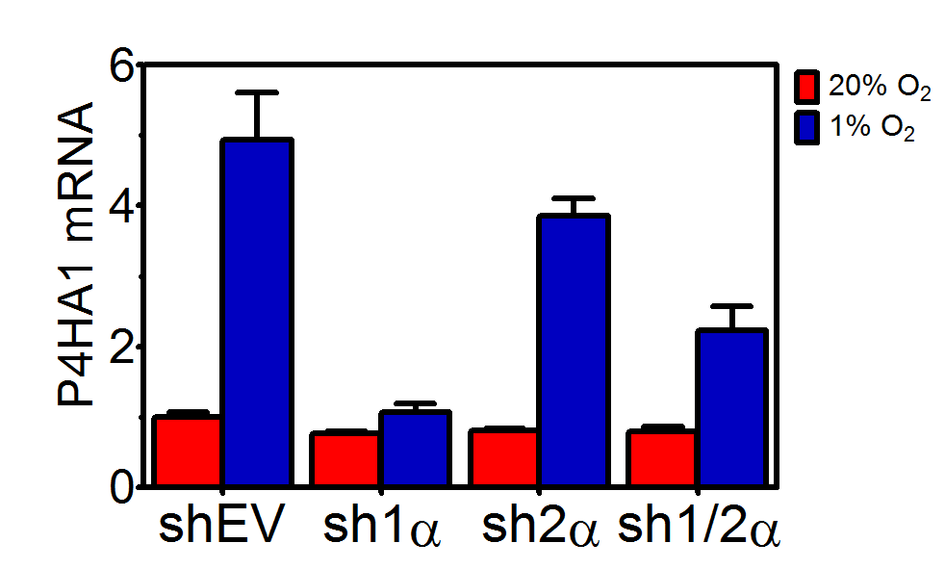
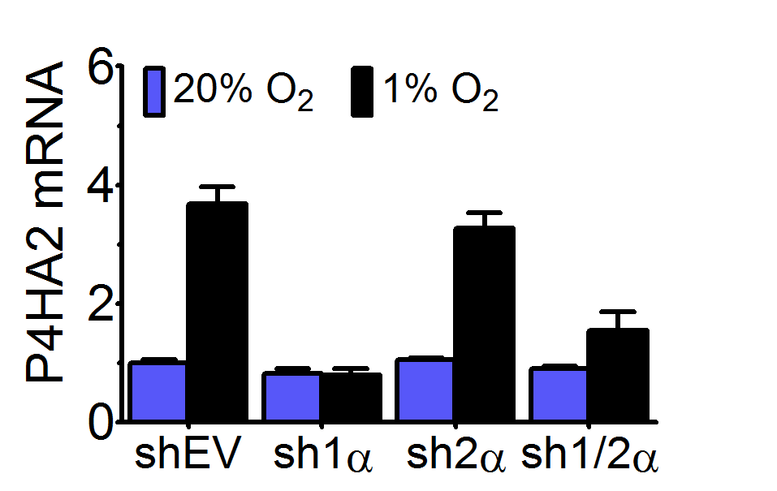
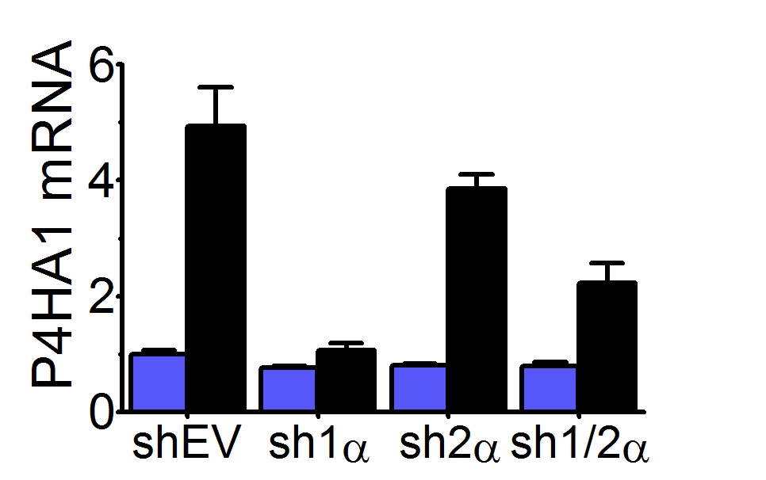
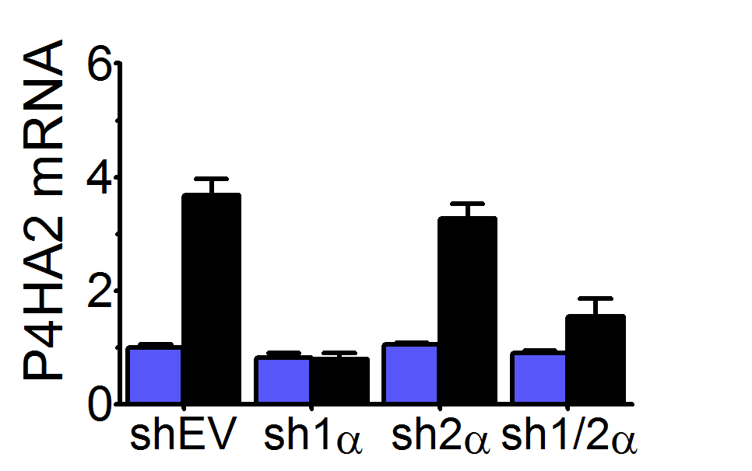
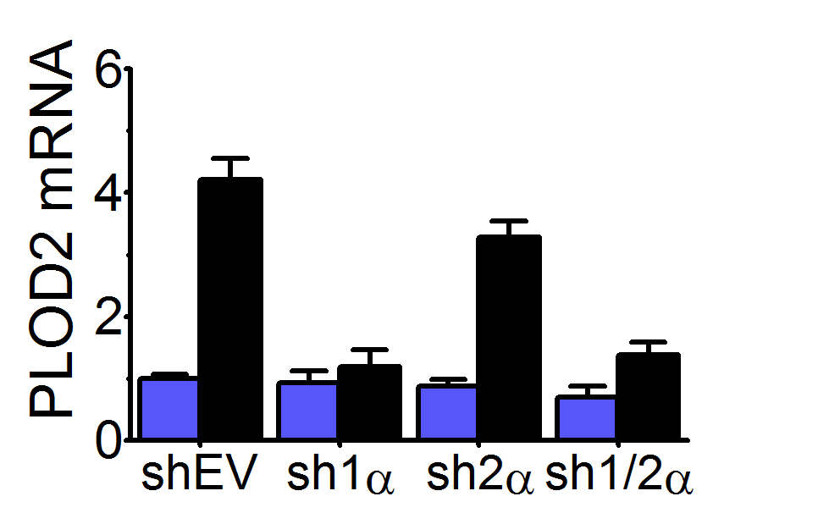
HIF-1α promotes collagen hydroxylase expression
***
***
***
***
***
***
###
***
###
###
###
###
###
***
Notes:
We generated MDA-MB-231 subclones stably transfected with an empty vector (EV) or expression vector(s) encoding shRNA targeting HIF-1α (sh1α), HIF-2α (sh2α), or HIF-1α and HIF-2α (sh1/2α) (8). We exposed these cells to 20% or 1% oxygen conditions. We generated RNA and subsequenty cDNA to assess the levels of P4HA1, P4HA2, and PLOD2 using RT-PCR. You can see that each of the enzymes are induced under hypoxic conditions but this is abroagated with the knockdown of HIF1 (but not HIF2).

Slide 24
P4HA1
P4HA2
PLOD2
Enhanced
Collagen
Production
HYPOXIA
HIF-1α
Clinical Relevance?

Slide 25
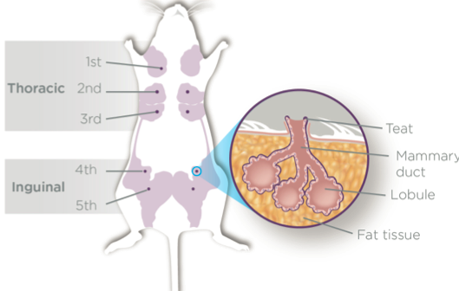
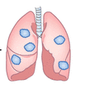
Mouse model for metastasis
Lung
Metastasis
Severe Combined Immunodeficient Mice
CTCs
MDA-MB-231 cells
(TNBC, basal)
Lymphatic
Metastasis

Slide 26
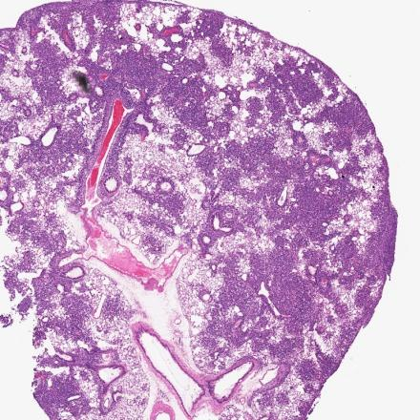
















Collagen prolyl hydroxylase KD prevents pulmonary metastasis
5 mm
5 mm
0.2 mm
shLKO.1
shHA1-1
shHA1-2
***
shHA2-1
shHA2-2

Slide 27






Collagen prolyl hydroxylase KD reduces lymphatic infiltration
Original
Vimentin
Hematoxylin
Threshold
***

Slide 28







Reducing prolyl hydroxylase expression suppresses fibrillar collagen deposition
shLKO.1
shP4HA1
shP4HA2
N
Polarized
N
N
***
Red Only
2.7 mm
Notes:
Next we assess fibrillar collagen content in the tumors from these mice. We stained tumor sections from each of these mice with siruis red dye and imaged the sections under polarized light. Collagen fibers have birefrigent properties making them appear red on a dark background. We subtract out all signals except for the red signal shown here and then quanitfy the area of red staining over the total area of tumor in the section to determine that control tumors consist of about 7% firbillar collagen. The knockdown of P4HA1 or P4HA2 reduces this to less than 1%.

Slide 29

Tumor stiffness
***
***
Tumor
Notes:
Since tumor stiffness has been implicated as a driver for tumor progression, we next measured the stiffness of the tumors using an indentation device. Using this device we can measure the force applied to the tumor and the distance of probe indentation. The more force needed to indent the tumor the stiffer the tumor. For each tumor we probe in 5-6 locations. We find that tumors stiffness is decreased by 50% for the collagen hydroxylase kds. This correlates with the reduction in collagen content that I just described.

Slide 30
Summary Part 1
Hypoxia promotes collagen deposition in the ECM
Collagen deposition promotes enhanced directional migration
P4HA1 or P4HA2 knockdown is sufficient to reduce collagen deposition
P4HA1 or P4HA2 knockdown reduces tumor burden and prevents metastasis
Tumor collagen content and stiffness is reduced when the expression of P4HA1 or P4HA2 is abrogated.

Slide 31

At least 300 functions for HIF-1 and HIF-2
Gilkes et al. Future Oncology, 2013

Slide 32
Is there a better way?
Permanent marking of hypoxia-exposed cells to “collect” changes as cells progress from a primary tumor to metastatic lesions.

Slide 33


Permanent marking of hypoxia-exposed cells
STOP
STOP
CMV
loxp
RFP
loxp
GFP
HIF-1α
HIF-2α
HRE
HRE
HRE
HRE
Min TK promoter
CRE
ODD
STOP
STOP
CMV
loxp
RFP
CMV
GFP

Slide 34




Hypoxia marking strategy in vitro
20% O₂
1% O₂

Slide 35




In vivo experimental set-up
time

Slide 36





Hypoxia marking strategy in tumors
GFP+
HYPOXYPROBE
2.0mm
RFP+
TUNEL

